Slide 1
Saratoga Springs
Historic Overlay maps

Slide 2
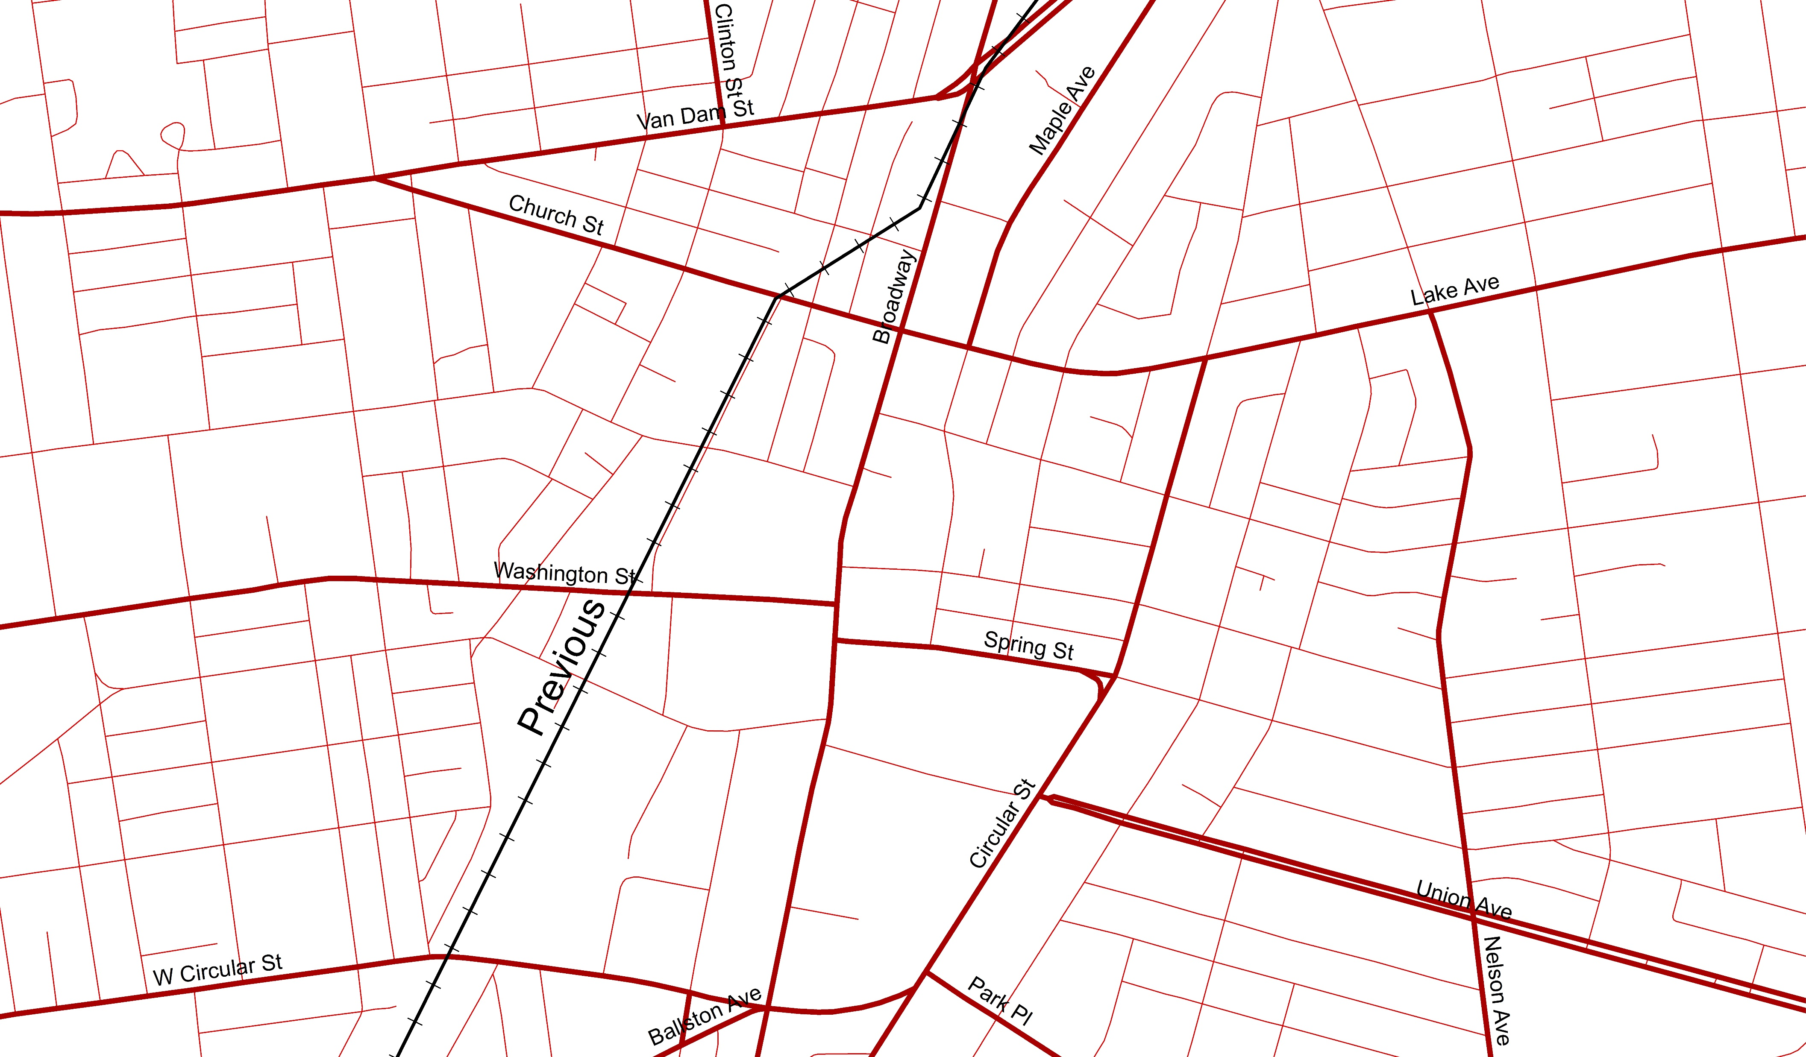
Current Streets

Slide 3
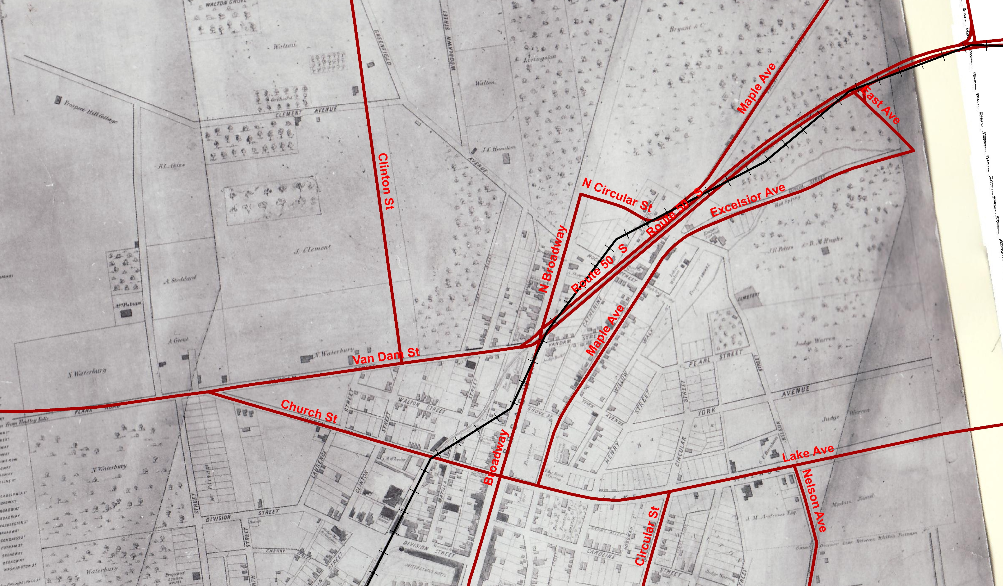
1852 Bevan

Slide 4
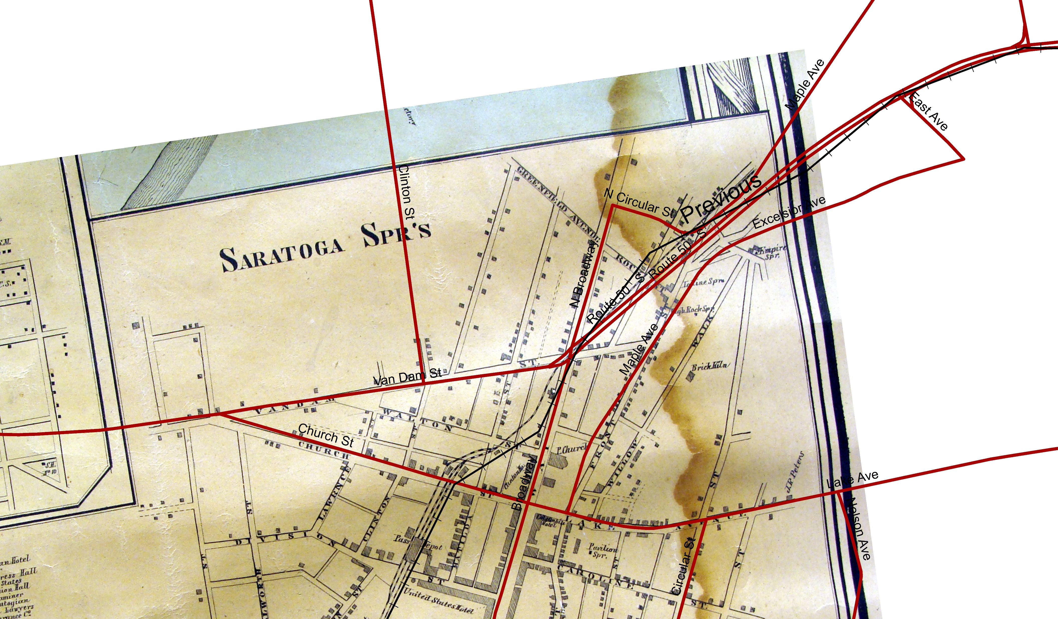
1856

Slide 5
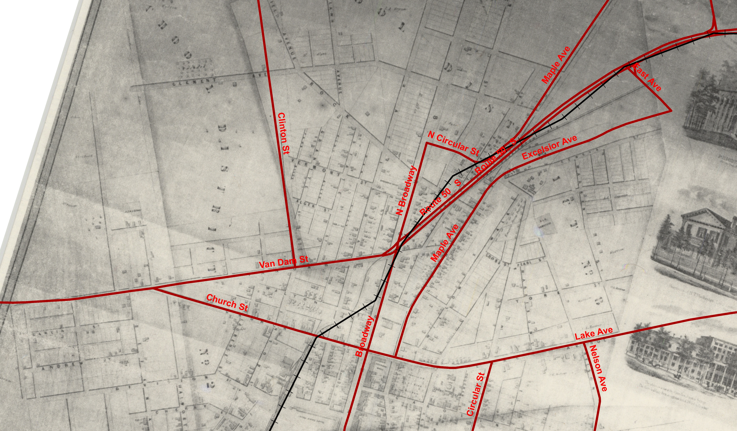
1858 Clark

Slide 6
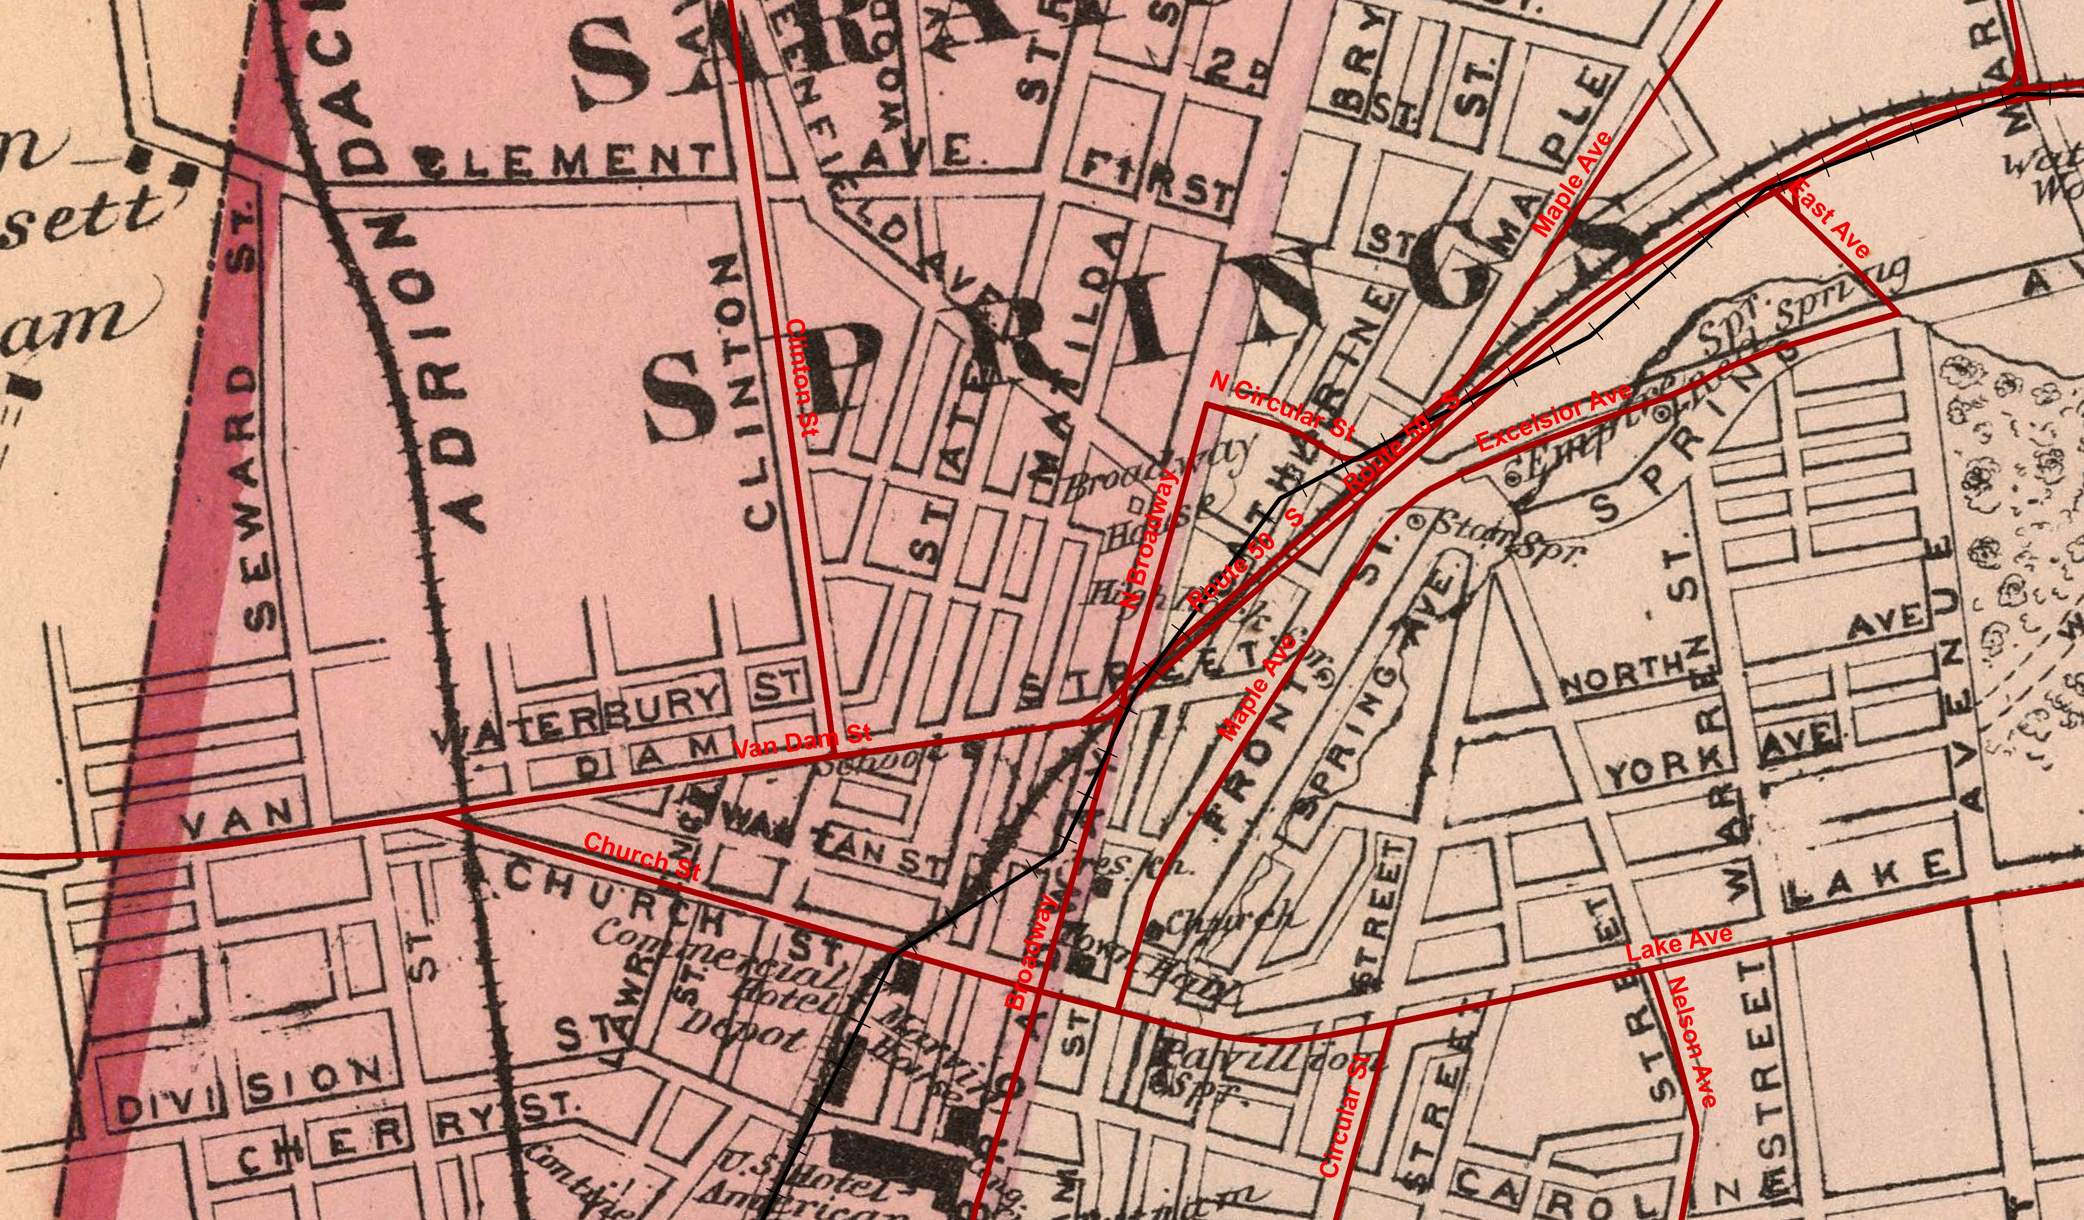
1876 Cramer

Slide 7
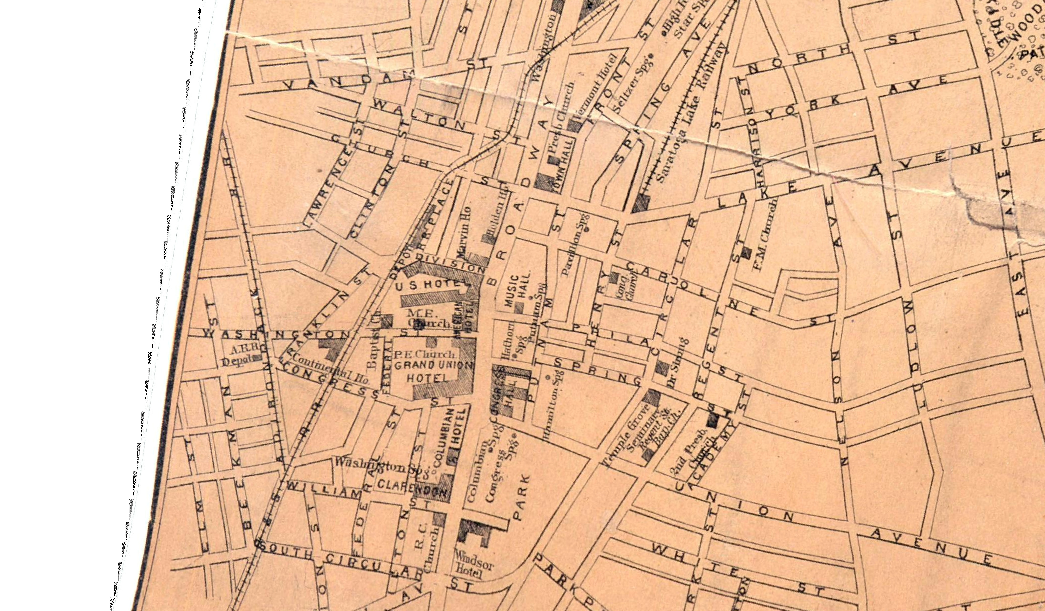
1881 Lawrence

Slide 8
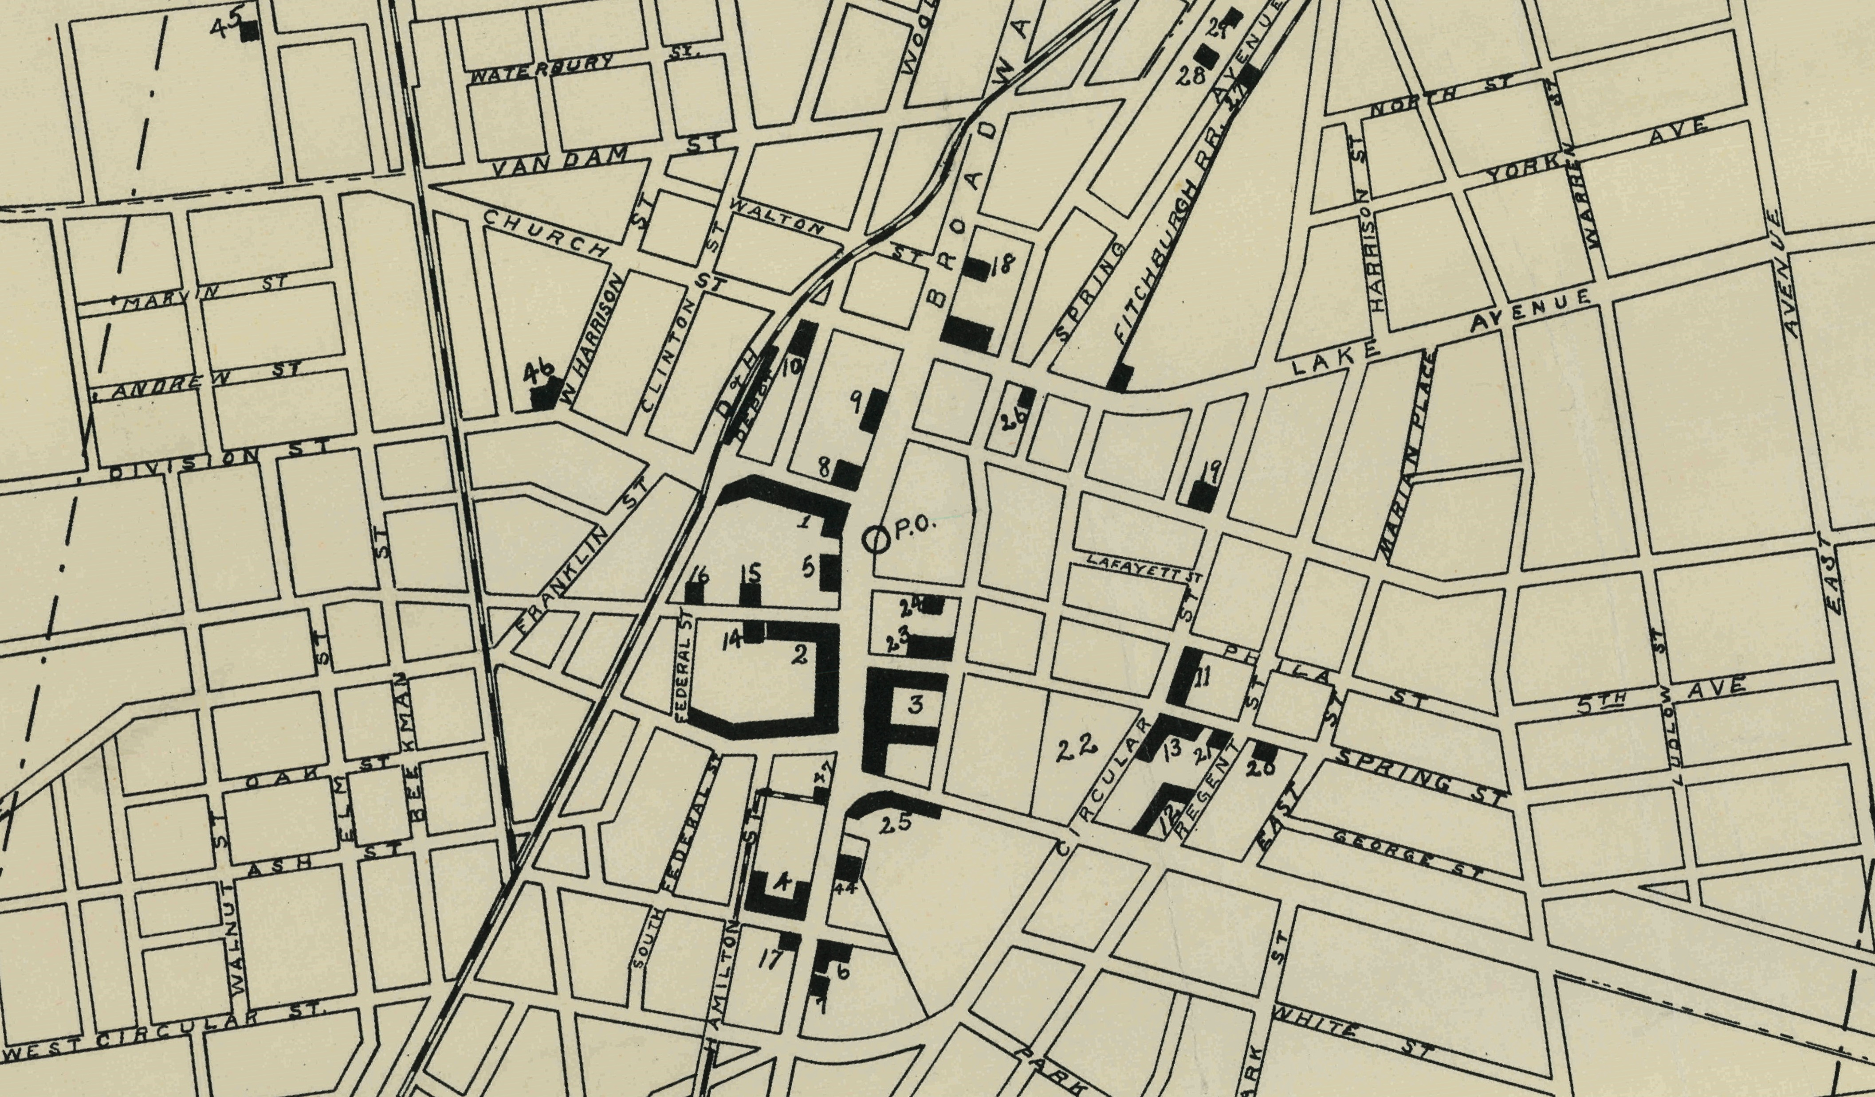
1901 Robson Adee

Slide 9
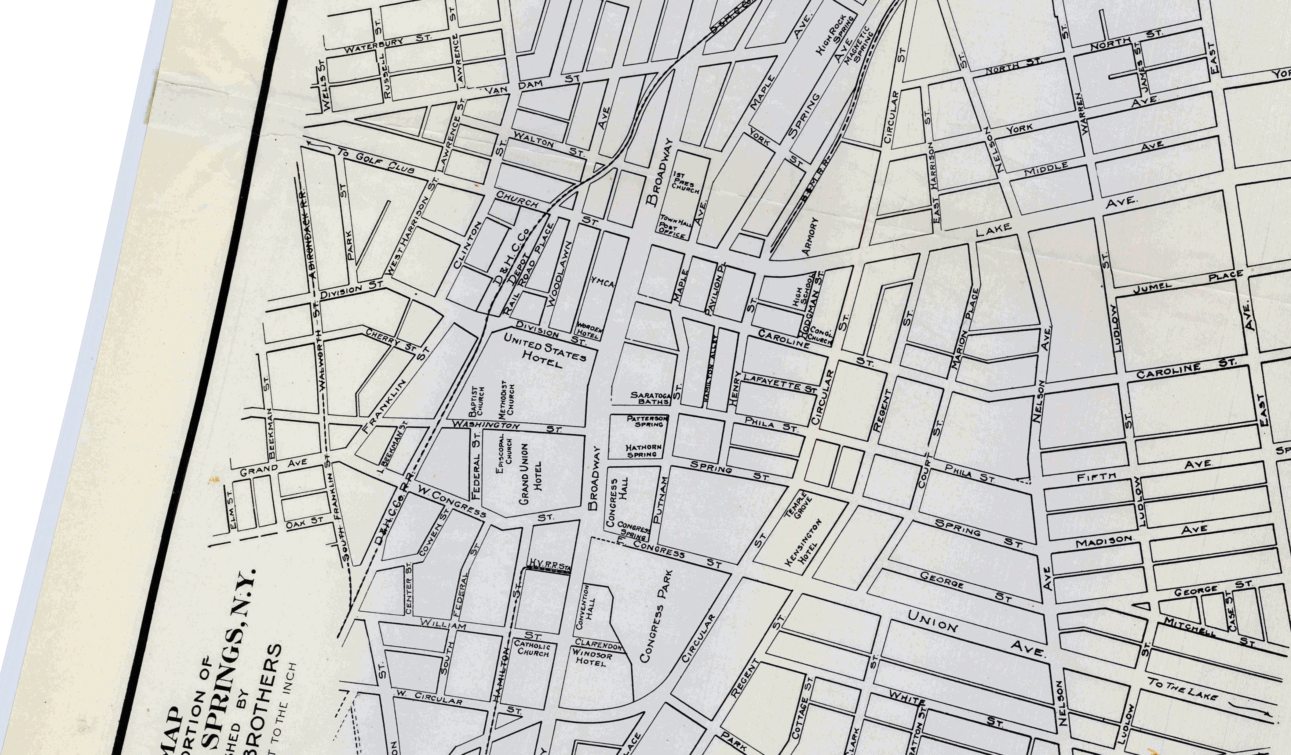
1903 Lester

Slide 10
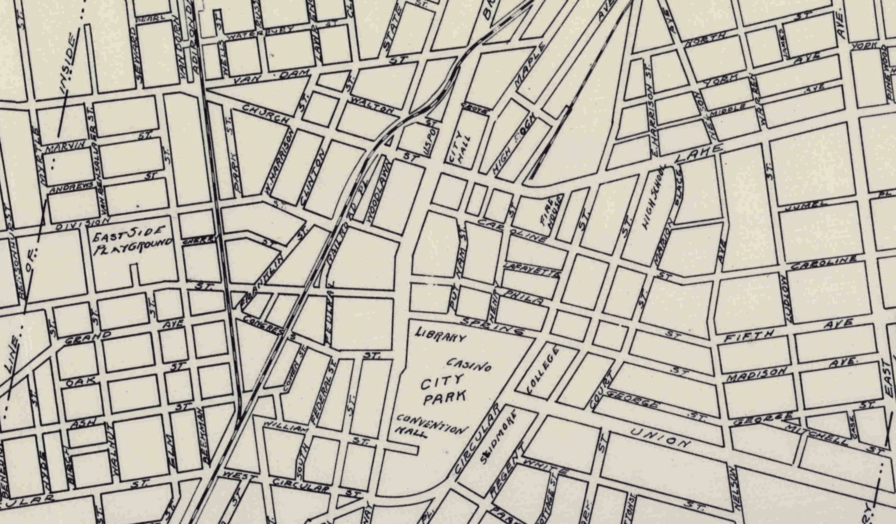
1932 Mott

Slide 11
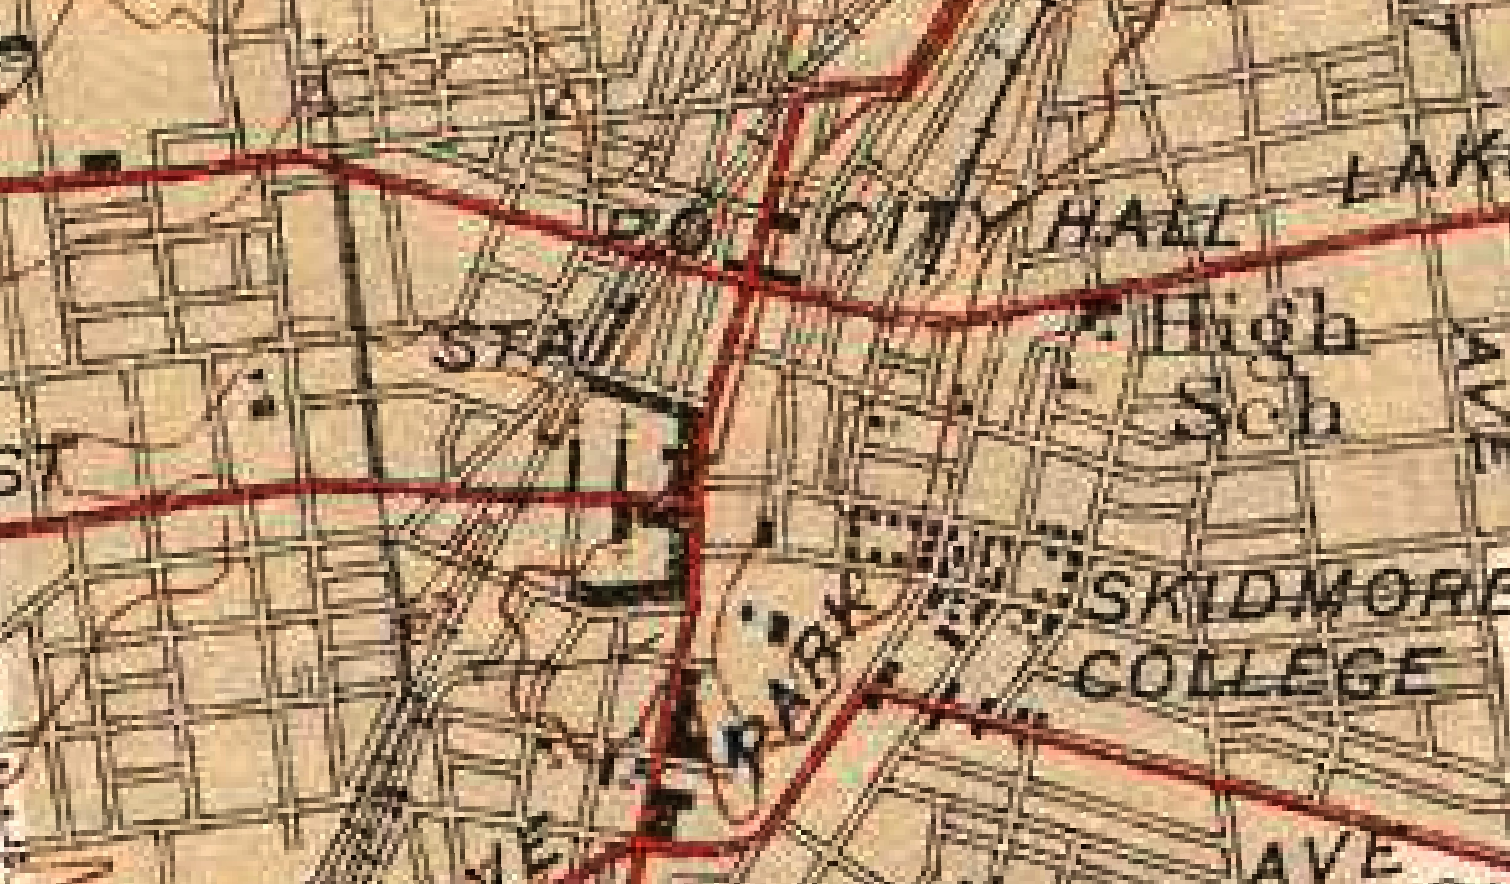
1942 TOPO

Slide 12
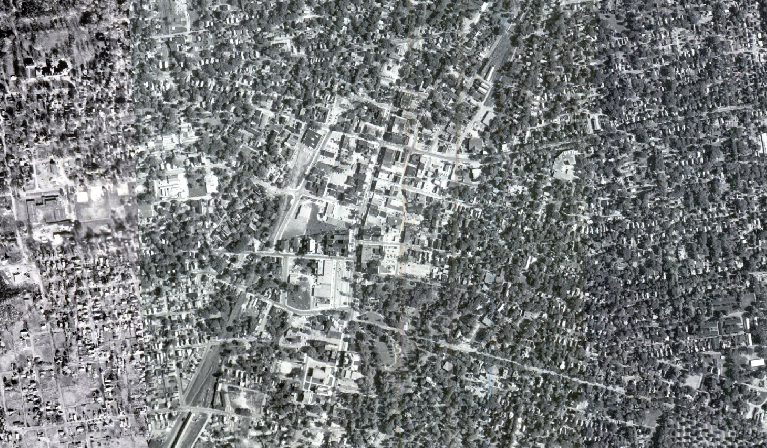
1960 Mosaic

Slide 13
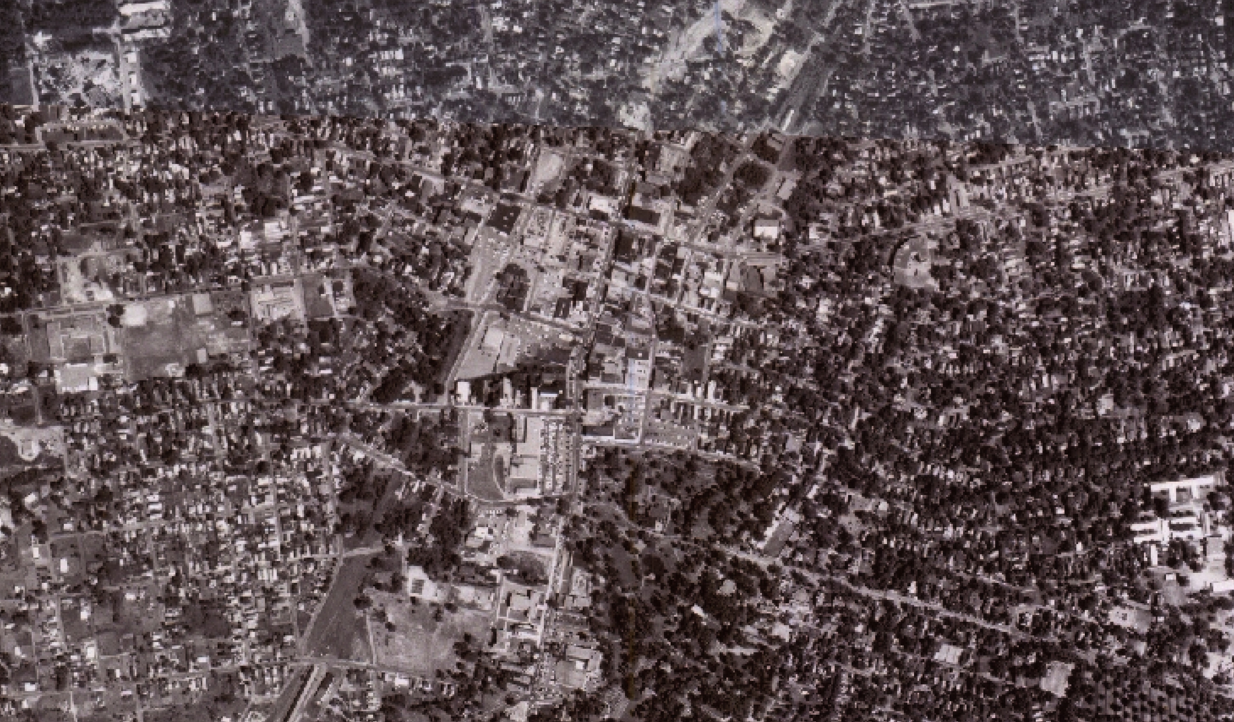
1968 Mosaic

Slide 14
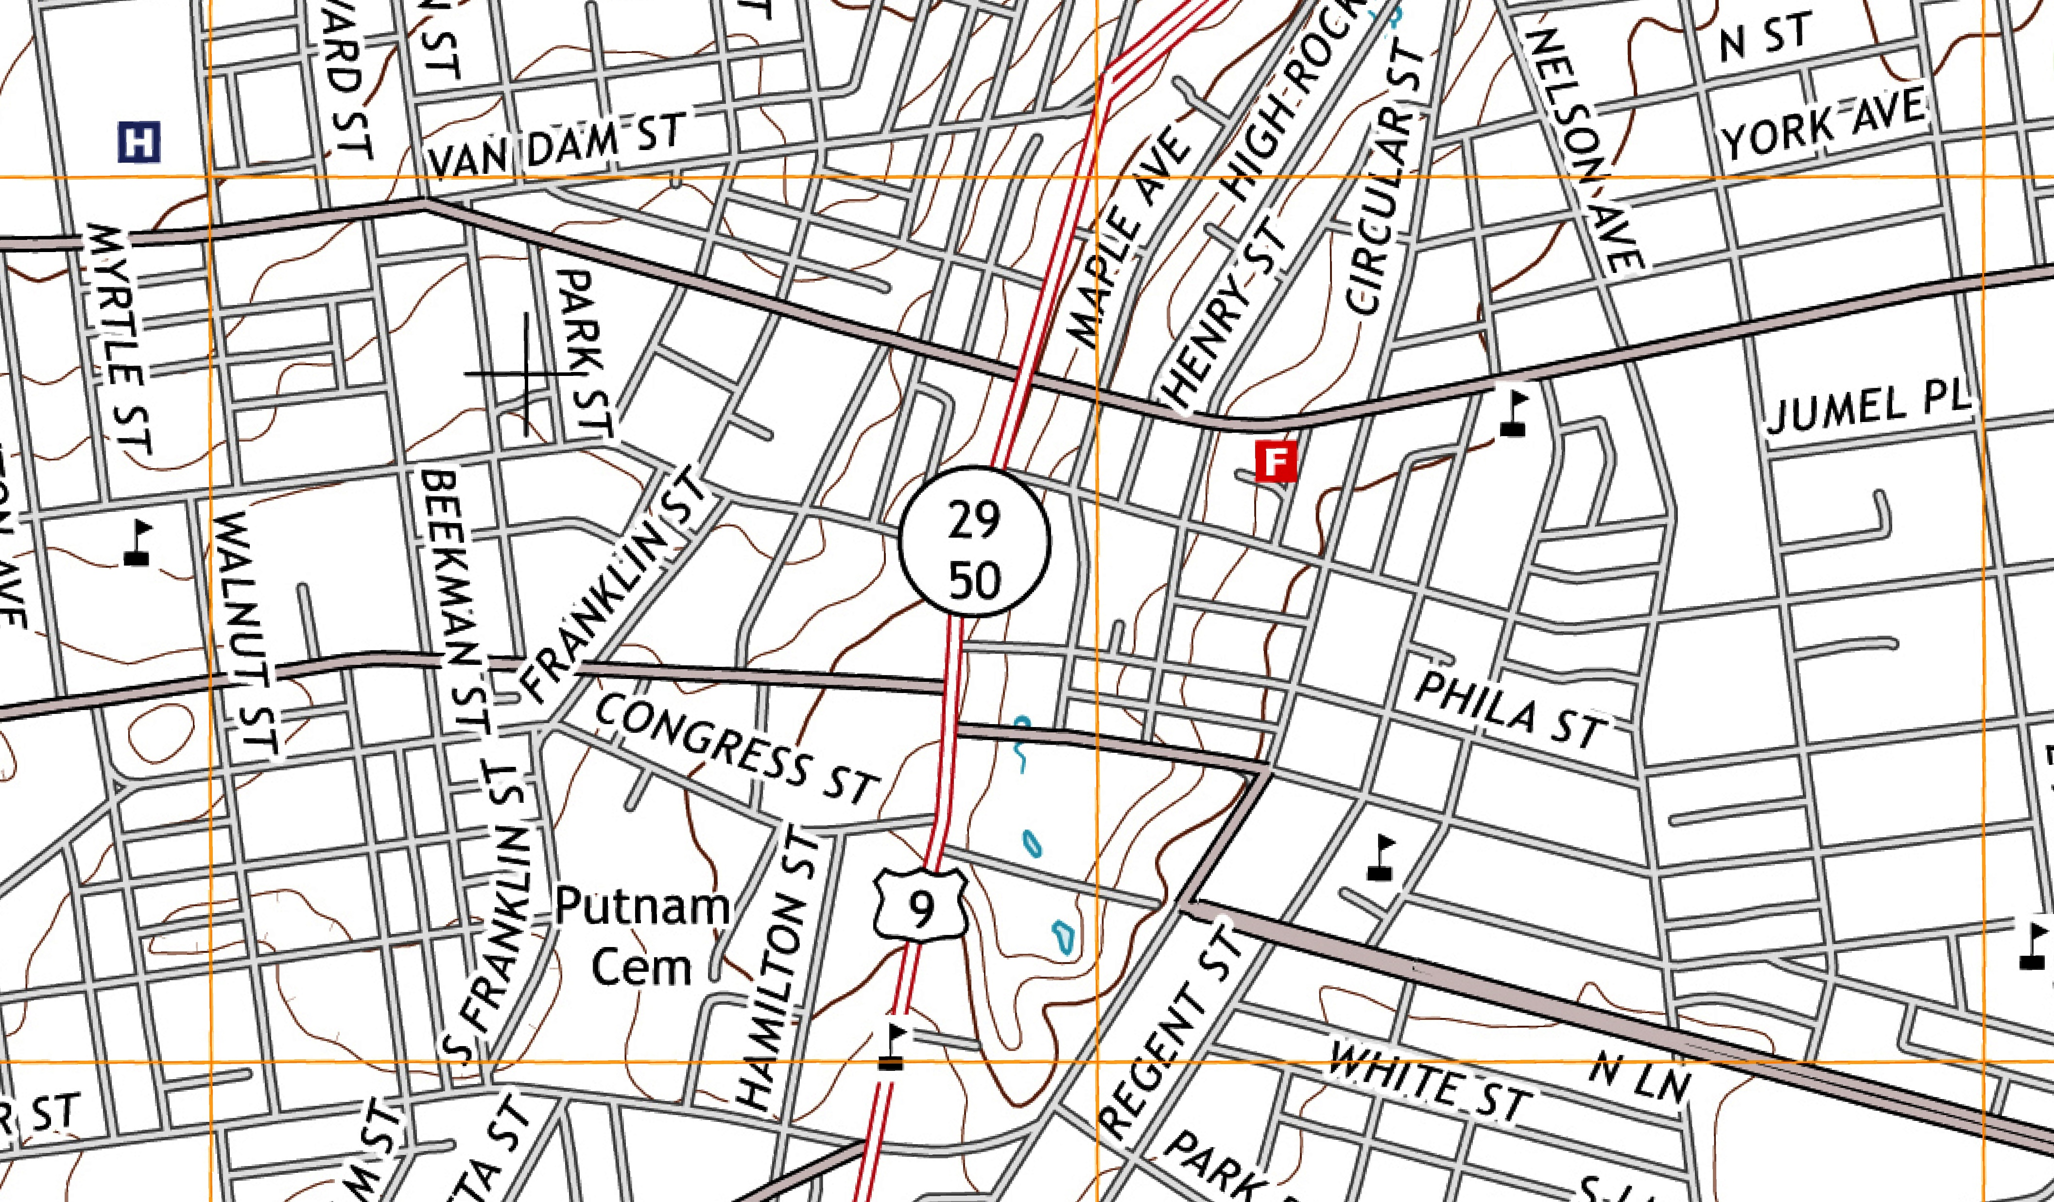
2013 TOPO

